Slide 1
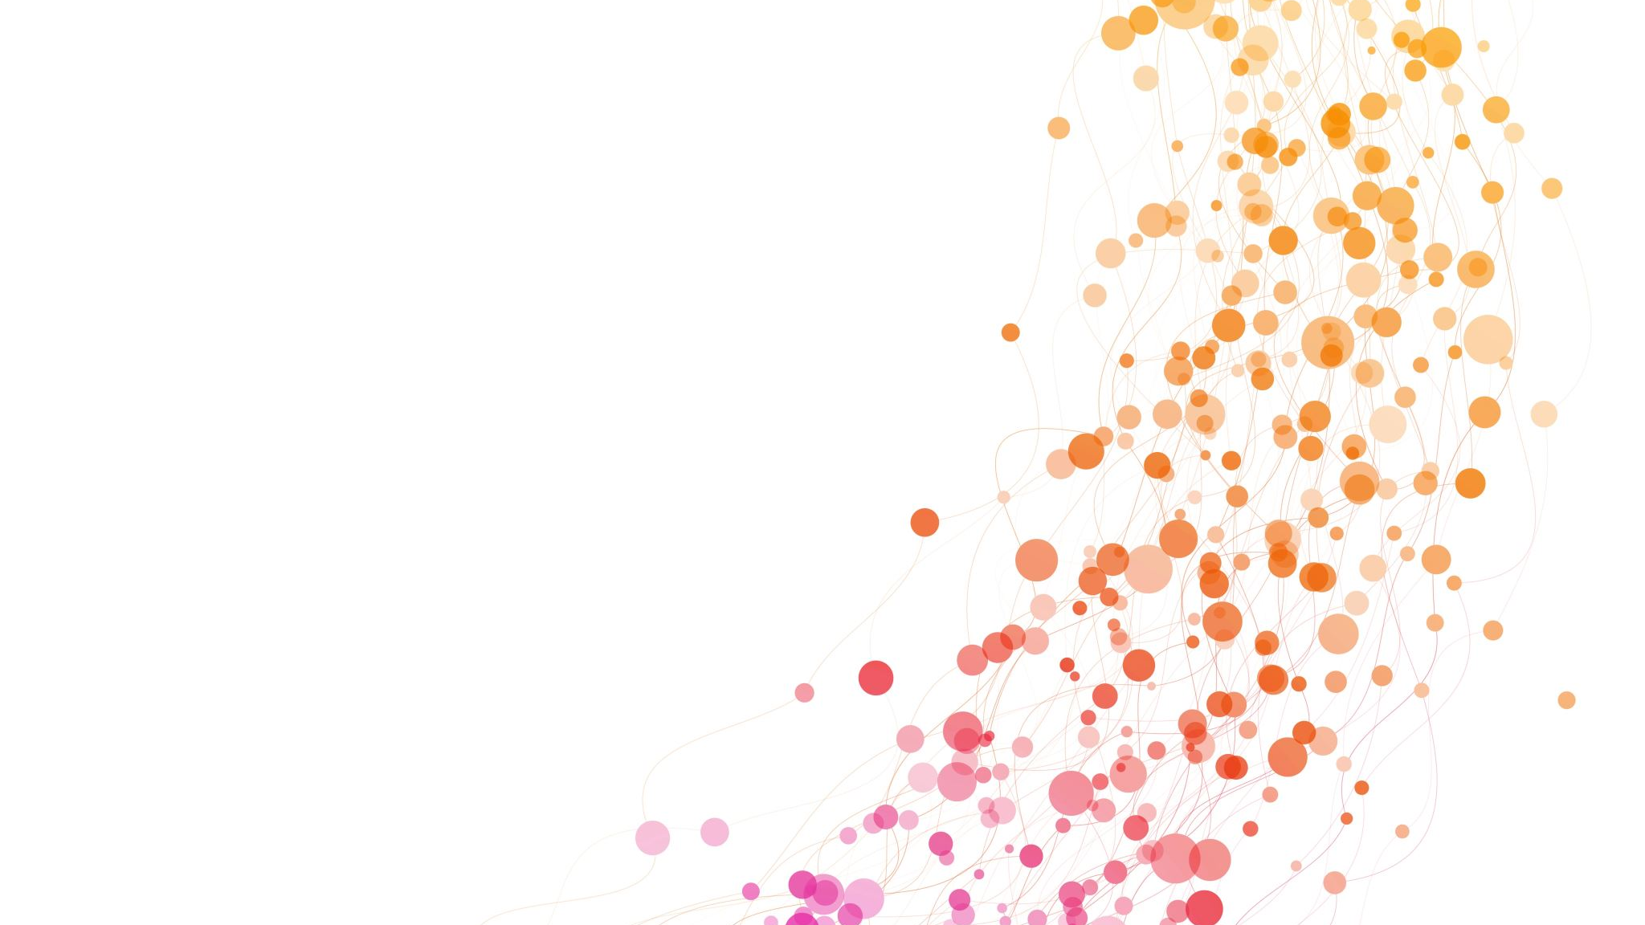
FACTORS ASSOCIATED WITH PAIN AMONG LONG STAY RESIDENTS IN NURSING HOMES IN THE US
Rhoda Nankabirwa
MSIS 642 P 1 01 Multivariate and Regression Spring 2022
Instructor: Prof Tong Wu

Slide 2
Outline
Motivation
Literature Review
Theory and Hypotheses
Data
Empirical Approach
Results
Conclusion
Reference

Slide 3

Introduction
Numerous studies have reported the prevalence of daily pain among long stay residents in nursing homes
However, due to the variations in survey methods used, there is a potential risk that pain may be under diagnosed among certain categories of patients/residents

Slide 4
Motivation
Pain is often under reported
Yet it can impact on the quality of life of institutionalized older people
Especially older residents who are likely to have challenges reporting pain
Coupled with organizational factors which may also be barriers for appropriate pain management

Slide 5
Motivation
Pain can impact mood and well-being
Pain can potentially interfere with daily activities
And therefore, may decrease the health-related quality of life in nursing home residents
Yet pain is often under reported

Slide 6
Lit Review
Pain among nursing home residents in the US and elsewhere in the world has been intensively studied.
Hunnicutt, et.al, 2017, Bae, 2020 and Brandauer, et.al 2020 summarized resident characteristics that may influence pain ascertainment. These include age, gender, race/ethnicity, cognitive functioning, activities of daily living assistance, among others.
However, the residents who cannot detect and self report pain may remain untreated (Fain, et.al, 2017), affecting their quality of life.
Organizational factors may also be barriers for appropriate pain management
The aim of this study was to investigate the association between selected nursing home and patient characteristics with pain in long-stay residents in USA nursing homes

Slide 7
Theory and Hypotheses
Hypotheses
Patient and facility characteristics determine the prevalence of pain among long-stay residents in nursing homes in the US
Research question
Does any association exist between patient and facility characteristics with pain prevalence among long stay residents?
H0: There is no association between the explanatory variables with pain prevalence among long stay residents
H1: There is no association between the explanatory variables with pain prevalence among long stay residents

Slide 8
Data
Data source: Provided by the Instructor
Time collected: 2013
Variables: 78
No individual patient data was available
15515 nursing homes in the US were part of the survey
Did not do any cleaning since it was considered ready

Slide 9

Empirical Approach
The dataset was loaded into R and only the explanatory variables of interest were “called”
Descriptive statistics were used to find the mean and standard deviation of the explanatory variables of interest
Nine resident and nine nursing home characteristics were analysed
Univariate and multivariate analysis were used to examine the association between pain and nursing home as well as resident characteristics

Slide 10
Descriptive statistics

Slide 11
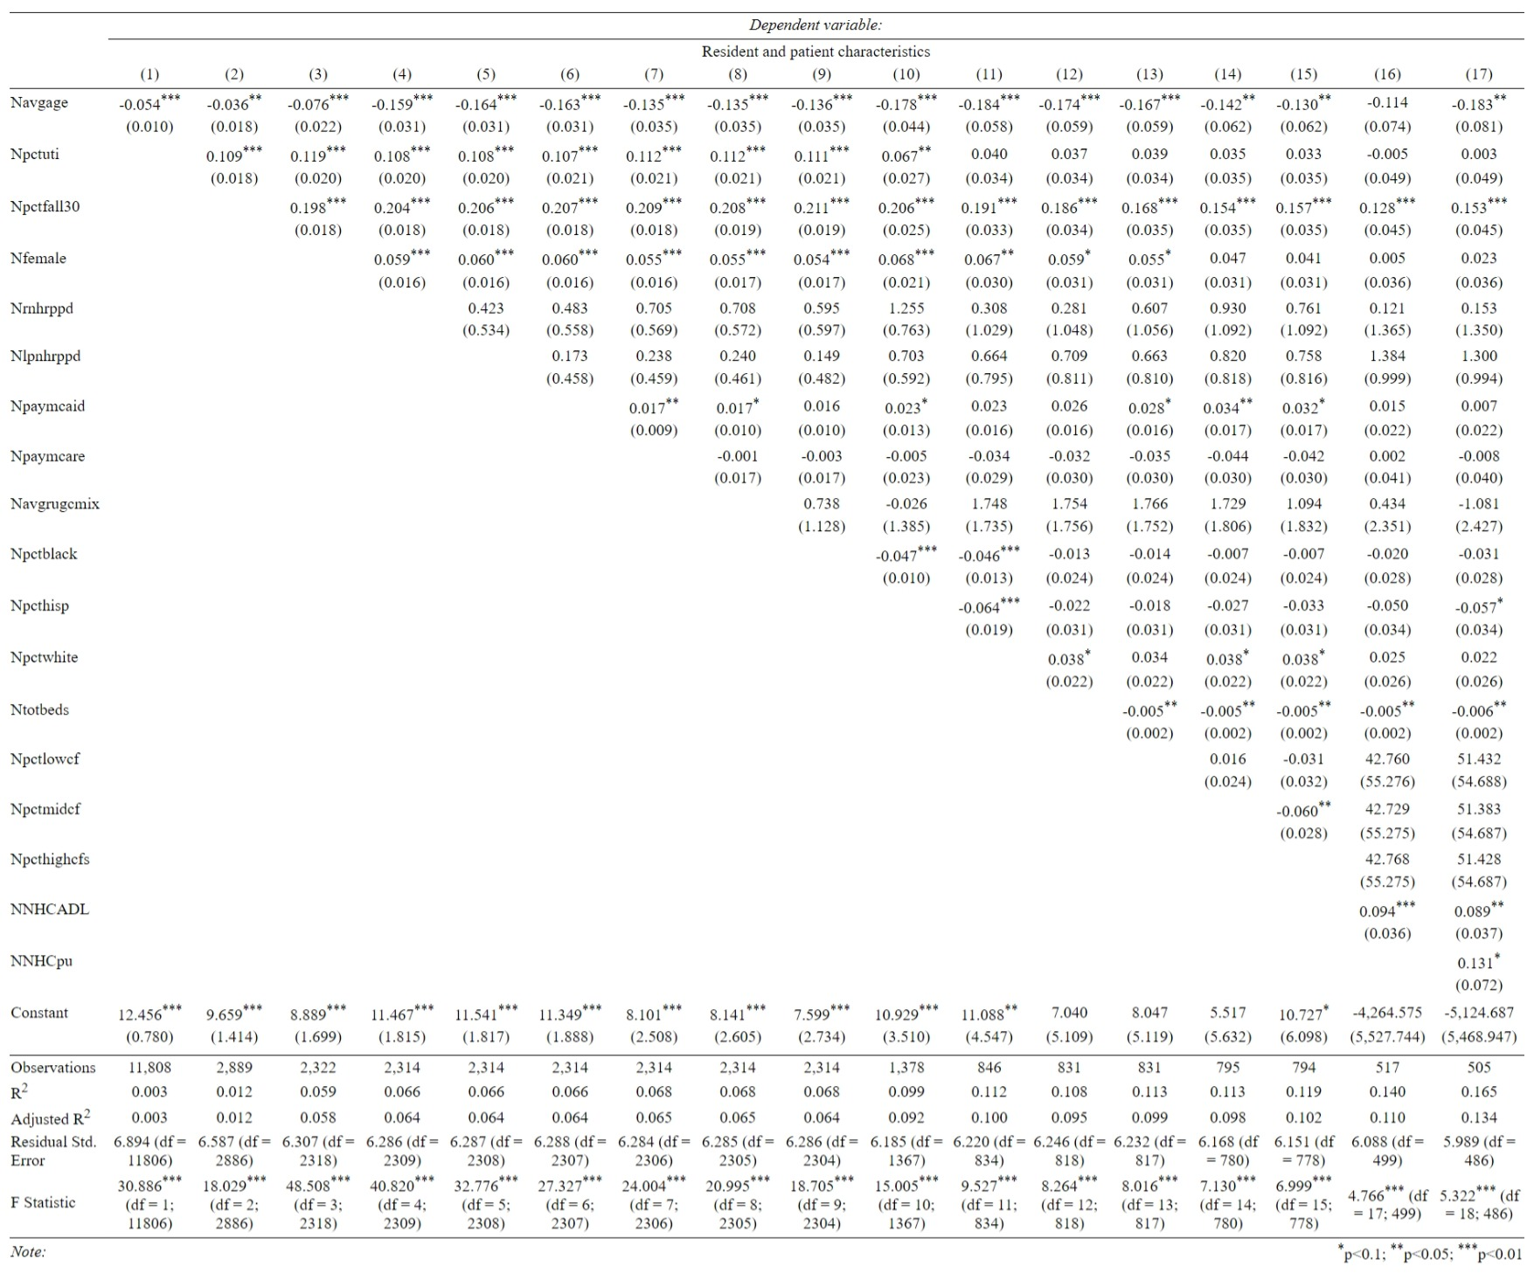

Slide 12
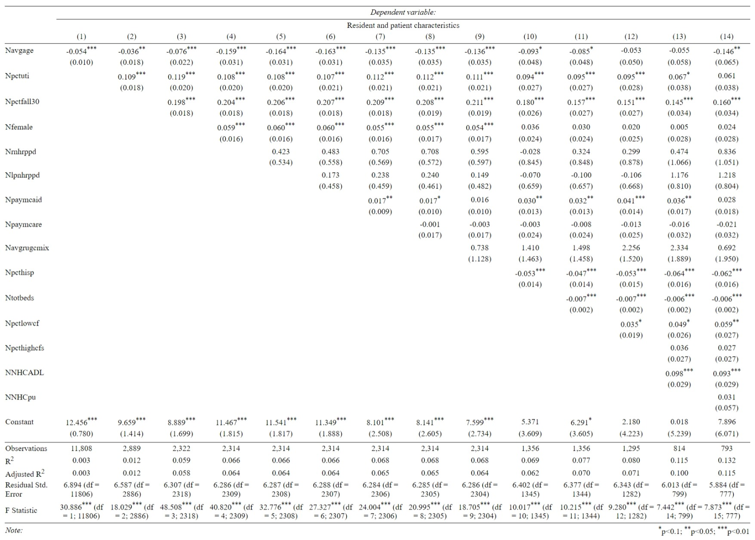
After correcting for multicollinearity and dropping Black and white resident population and moderate cognitive impairment

Slide 13
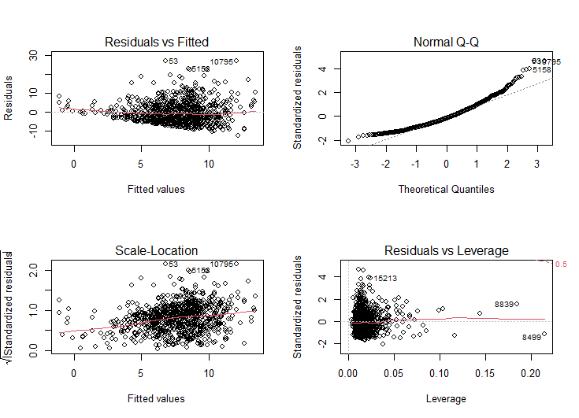
Residual plots: Testing for Non-Linearity
The model was linear

Slide 14
Results and interpetation
At the p-value 0.05, we reject the null hypothesis that there is no association between the explanatory variables with pain prevalence among long stay residents
It can be concluded that a fall within the last 30 days and proportion of Hispanic residents are significant predictors of pain among long-stay residents in US Nursing homes
NHCpain_2011p= 7.89 +0.16*Npctfall30 -0.06Npcthisp
Interpretation:
If the proportion of residents who fell in the last 30 days at the facility was increased by 1%, the proportion of long stay residents in pain is predicted to increase by 0.16%
If the proportion of the Hispanic residents at a facility was increased by 1%, the proportion of long stay residents in pain is predicted to decrease by 0.06%

Slide 15
Conclusion
The findings underline the importance of guarding against Falls in order to reduce the prevalence of pain
Since being white was highly correlated with other variables and being Hispanic significantly associated with pain, Blacks may not be reporting pain

Slide 16
References
Bae, S. H., Lee, S., & Kim, H. (2020). Extent of and factors associated with pain among older residents in nursing homes in South Korea: A nationwide survey study. Geriatrics & Gerontology International, 20(2), 118-124
Brandauer, A., Berger, S., Freywald, N., Gnass, I., Osterbrink, J., Seidenspinner, D., & Kutschar, P. (2020). Quality of life in nursing home residents with pain: pain interference, depression and multiple pain-related diseases as important determinants. Quality of Life Research, 29(1), 91-97.
Fain, K. M., Alexander, G. C., Dore, D. D., Segal, J. B., Zullo, A. R., & Castillo‐Salgado, C. (2017). Frequency and predictors of analgesic prescribing in US nursing home residents with persistent pain. Journal of the American Geriatrics Society, 65(2), 286-293.
Guliani, H., Hadjistavropoulos, T., Jin, S., & Lix, L. (2020). Utilization of health care resources by long-term care residents as a function of pain status. The Clinical Journal of Pain, 36(6), 472.
Hunnicutt, J. N., Ulbricht, C. M., Tjia, J., & Lapane, K. L. (2017). Pain and pharmacologic pain management in long-stay nursing home residents. Pain, 158(6), 1091.

